Slide 1
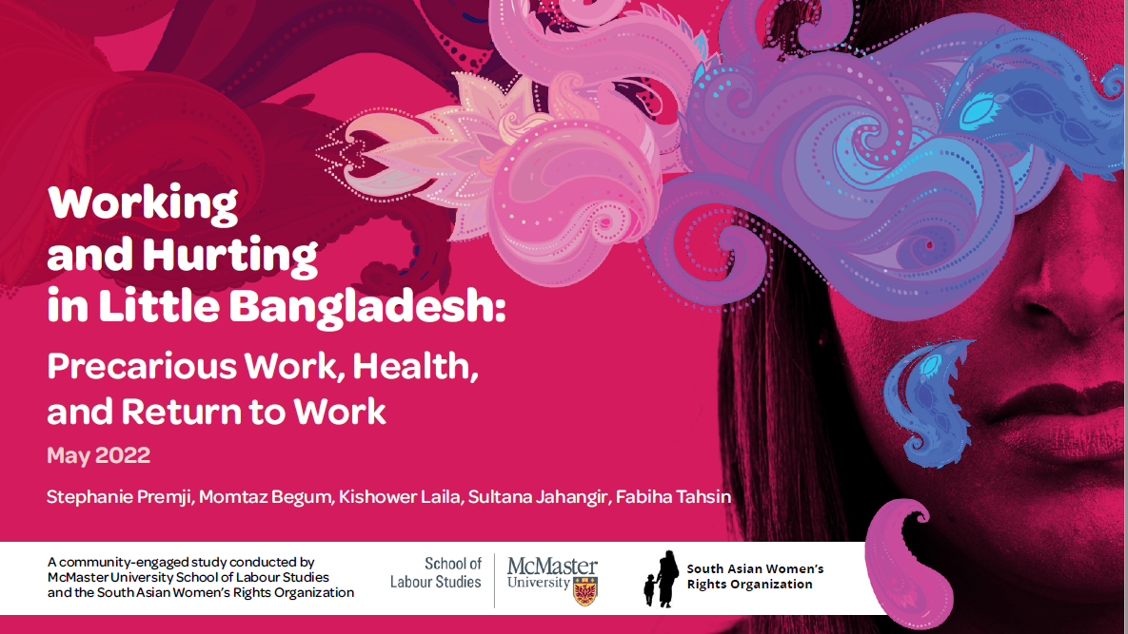

Slide 2
Context
Widespread precarious employment and health problems due to work in the Bangladeshi community
Lack of understanding of how policies and practices shape workers’ health and safety experiences

Slide 3
What happens when you get hurt or sick at work when your work is not stable or secure?

Slide 4
Methods
Community-based approach
Study conducted between August 2020 and August 2021
Recruitment through SAWRO and social media
Interviews with 45 workers and 11 key informants
All worker interviews conducted in Bangla
Data managed with NVIVO, analysed collectively

Slide 5
Characteristics of worker participants
69% women
64% between the ages 31-50
87% had children and 84% were married
84% in Canada for ten years
89% had a postsecondary education
Worked in factories (36%), retail and restaurants (38%), childcare (20%), and security (7%)

Slide 6
Precarious employment
“..in some instances, say I would be working at a factory for 7 days straight. So I went to work as usual and they said there’s no more work starting tomorrow. Which means they knew from the beginning that the job was only going to last a few days……in the meantime, I could get calls from other agencies to do their job but I would refuse because of this job…Then suddenly, one afternoon they would call us and say you have work at night. But we’re forced to take it, right?”
Rakhi -Worker

Slide 7
Hazards
“In this job, we had to bring heavy and thick steel plates to the cutting machines and cut them there. After cutting, we had to bend them in another machine. It wasn’t as easy as it sounds. … Workers often get injured while handling them. Many workers got their fingers cut and injured. Accidents can happen there anytime. …. We had to carry the work-in-progress manually. They make the workers do [tasks a machine should do]. And agency workers means the factory has no responsibility for them...”
Ali -Worker

Slide 8
Health issues
“They behaved very badly. I realized after a while that it was not possible to adjust to that environment, so I quit. I was getting very physically ill day by day with many different ailments, went to the doctor they said I had hypertension, high blood pressure, got diagnosed with diabetes, UTI among many things. All of this occurred due to the mental stress from that job. I had to endure a lot because there was no way, if I didn't work how would I pay rent, how do I support my family and household and kids, a lot of issues. So, we were forced to endure the torture by the managers.”
Tania -Worker

Slide 9
Response to injuries and illnesses
Workers typically did not report or delayed reporting because of:
Lack of information
Claim suppression by employers
Disengagement of doctors
Concerns about workers’ compensation
Precarious employment context

Slide 10
“Anyway, I thought I would get some support from my workplace. I thought they would give me benefit for the days I was unable to work. But they were continuously pressuring me to return to work the next day. I mean my manager called me the next day. I became afraid and thought that if I don’t go the next day, they might fire me. I needed that job.”
Nahida -Worker

Slide 11
Impacts
Impacts of delayed or non-reporting on:
Health and well-being
Access to workers’ compensation
Return-to-work

Slide 12
The COVID-19 pandemic
Increased precarity
Additional risk and cost
Disproportionate impact on women

Slide 13
Conclusions
Our findings have implications for:
Employment integration
Employment conditions
Social safety net
Prevention
Compensation

Slide 14
Thank you!
spremji@mcmaster.ca
This study was funded by the Social Sciences and Humanities Research Council

